Slide 1
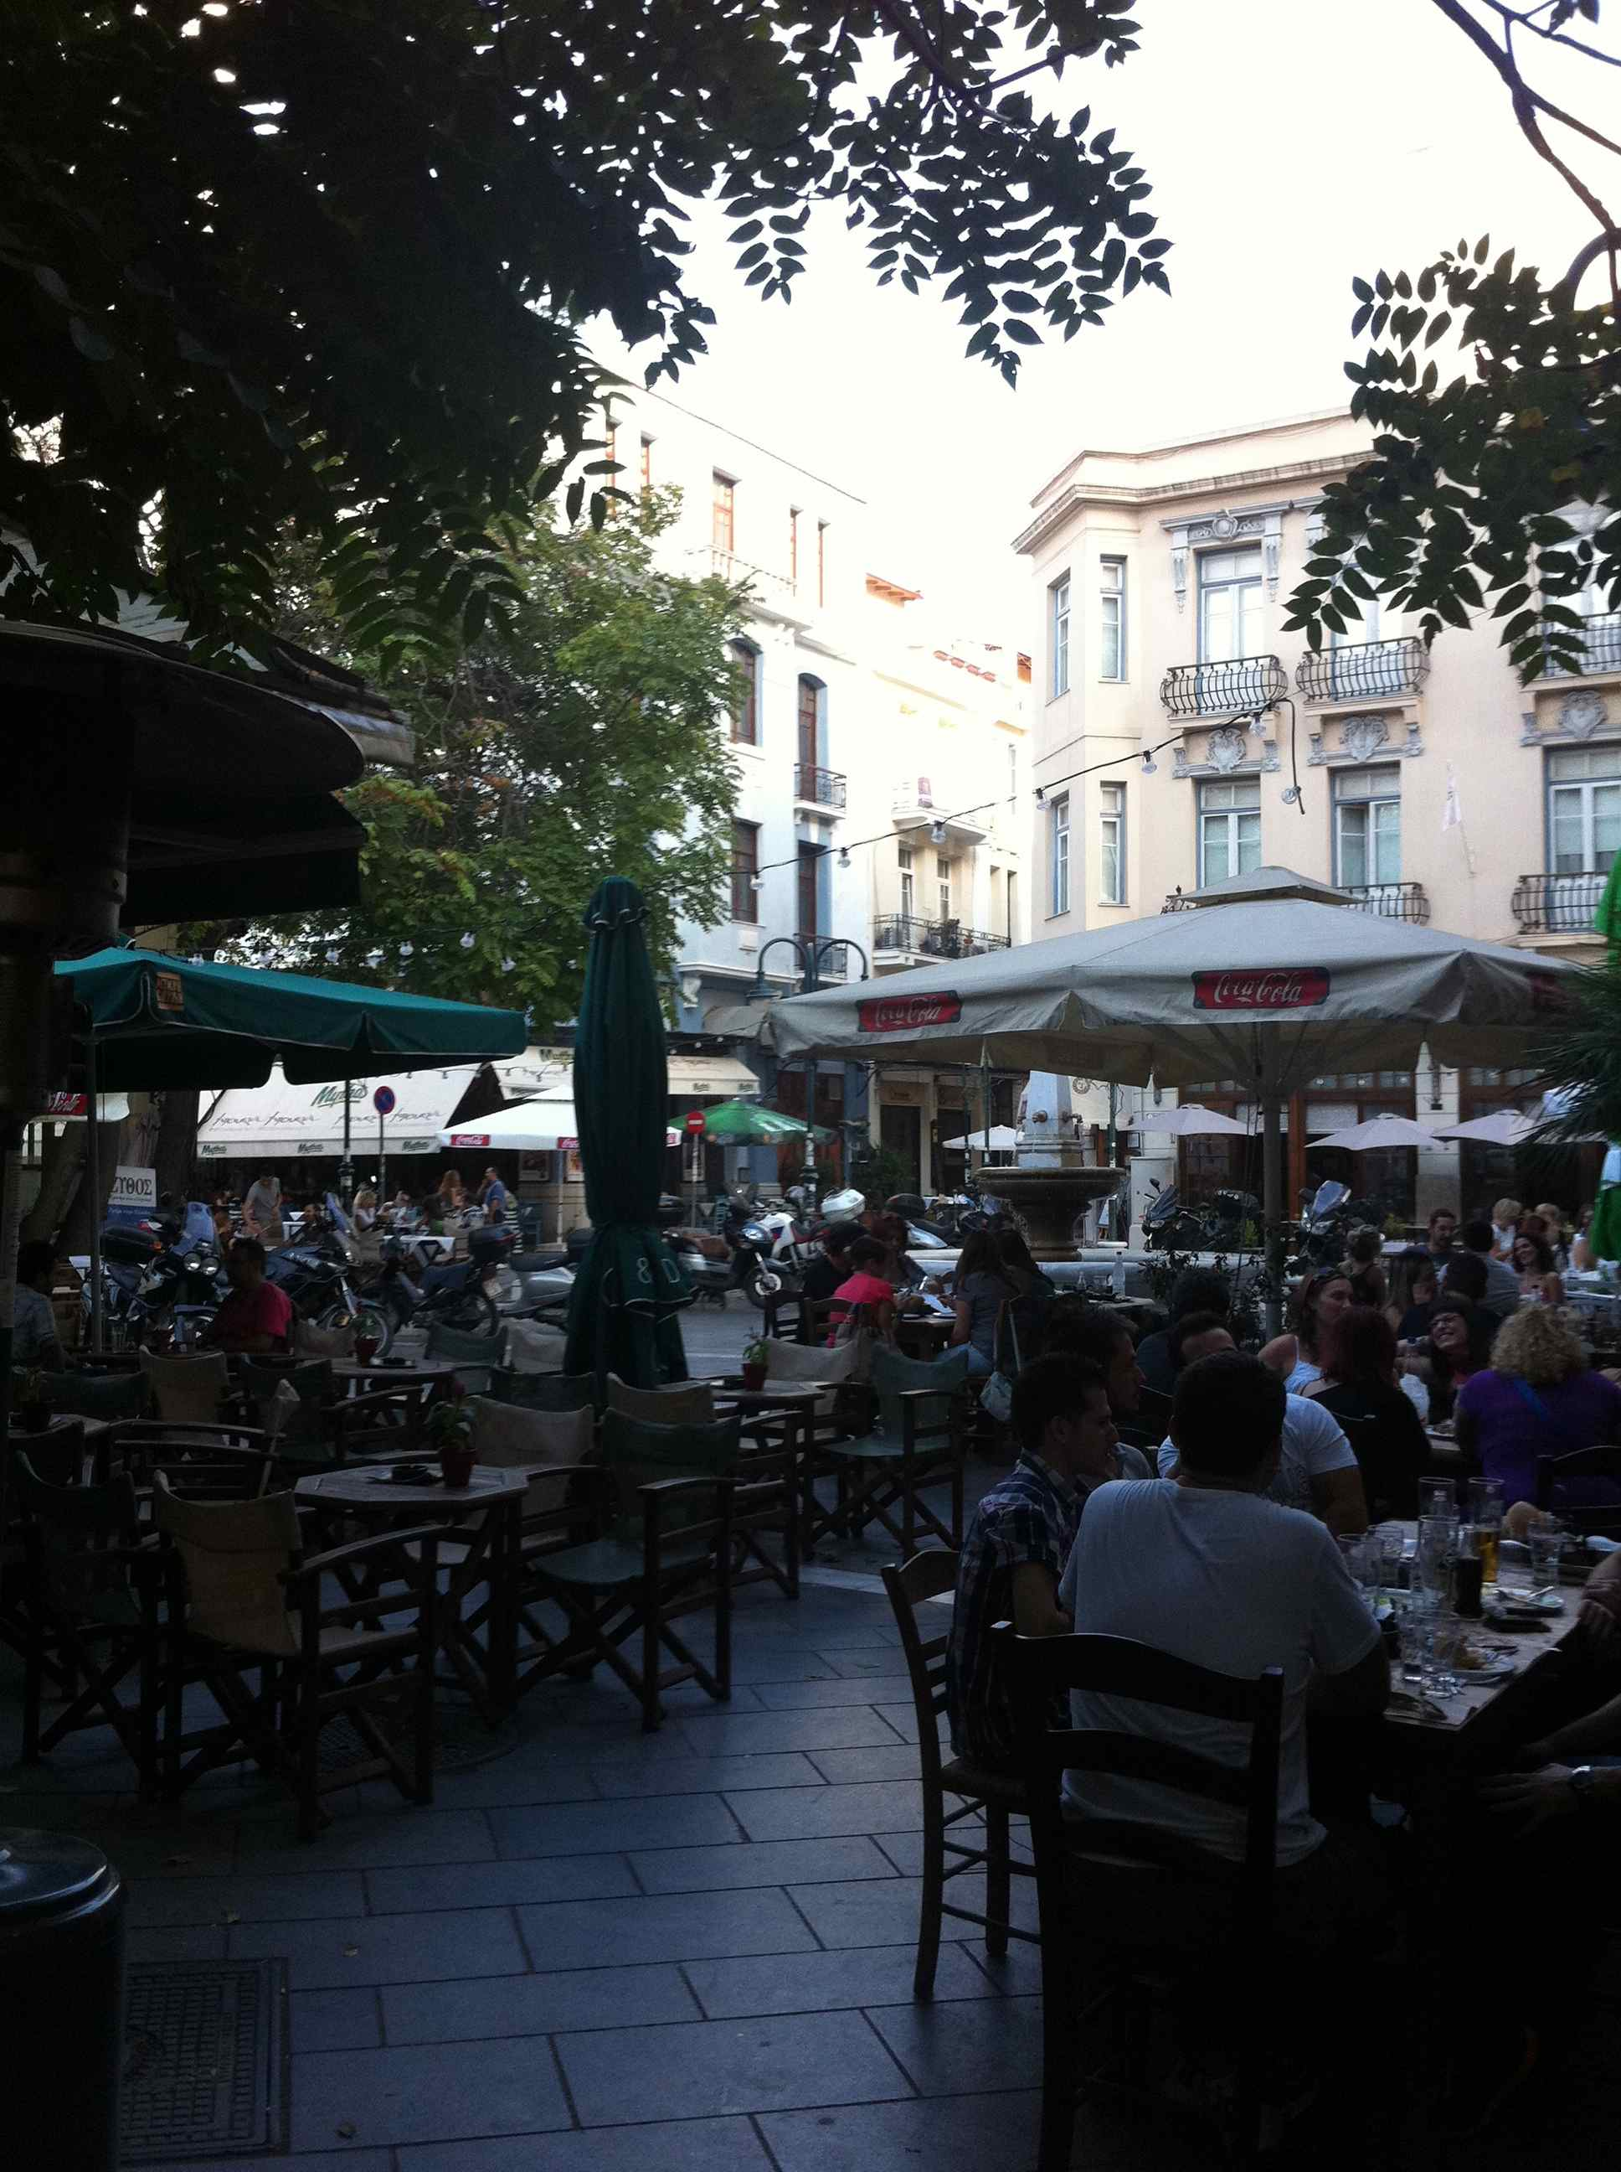
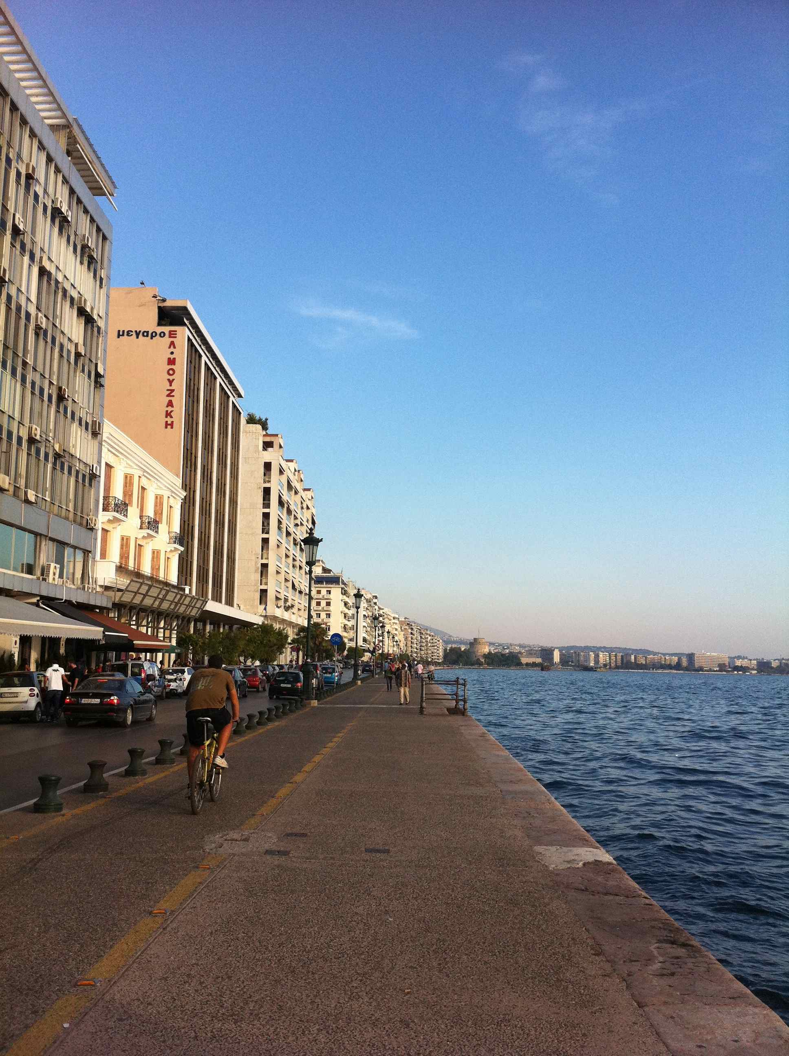

New ecologies and trajectories of learning
Gráinne Conole
University of Leicester
1st October 2012
InSuEdu conference
Thessaloniki, Greece
National Teaching
Fellow 2012

Slide 2
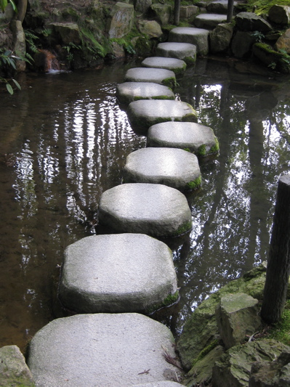
Outline
Technologies trends
Technologies for learning
Teacher practice and paradoxes
Learning Design
E-Pedagogies & technologies
Facets of learning
Ecologies of learning
Conclusion

Slide 3
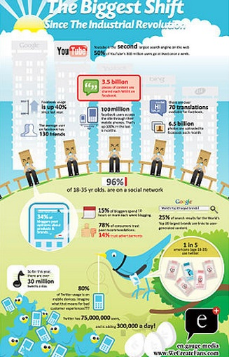
http://www.flickr.com/photos/maxoz/5655569031/

Slide 4
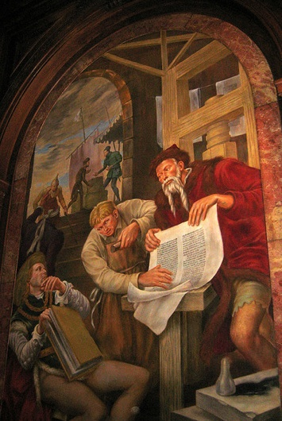

Gutenberg to Zuckerberg
Take the long view
The web is not the net
Disruption is a feature
Ecologies not economics
Complexity is the new reality
The network is now the computer
The web is evolving
Copyright or copywrong
http://www.flickr.com/photos/wallyg/2617472088/
http://memex.naughtons.org/

Slide 5
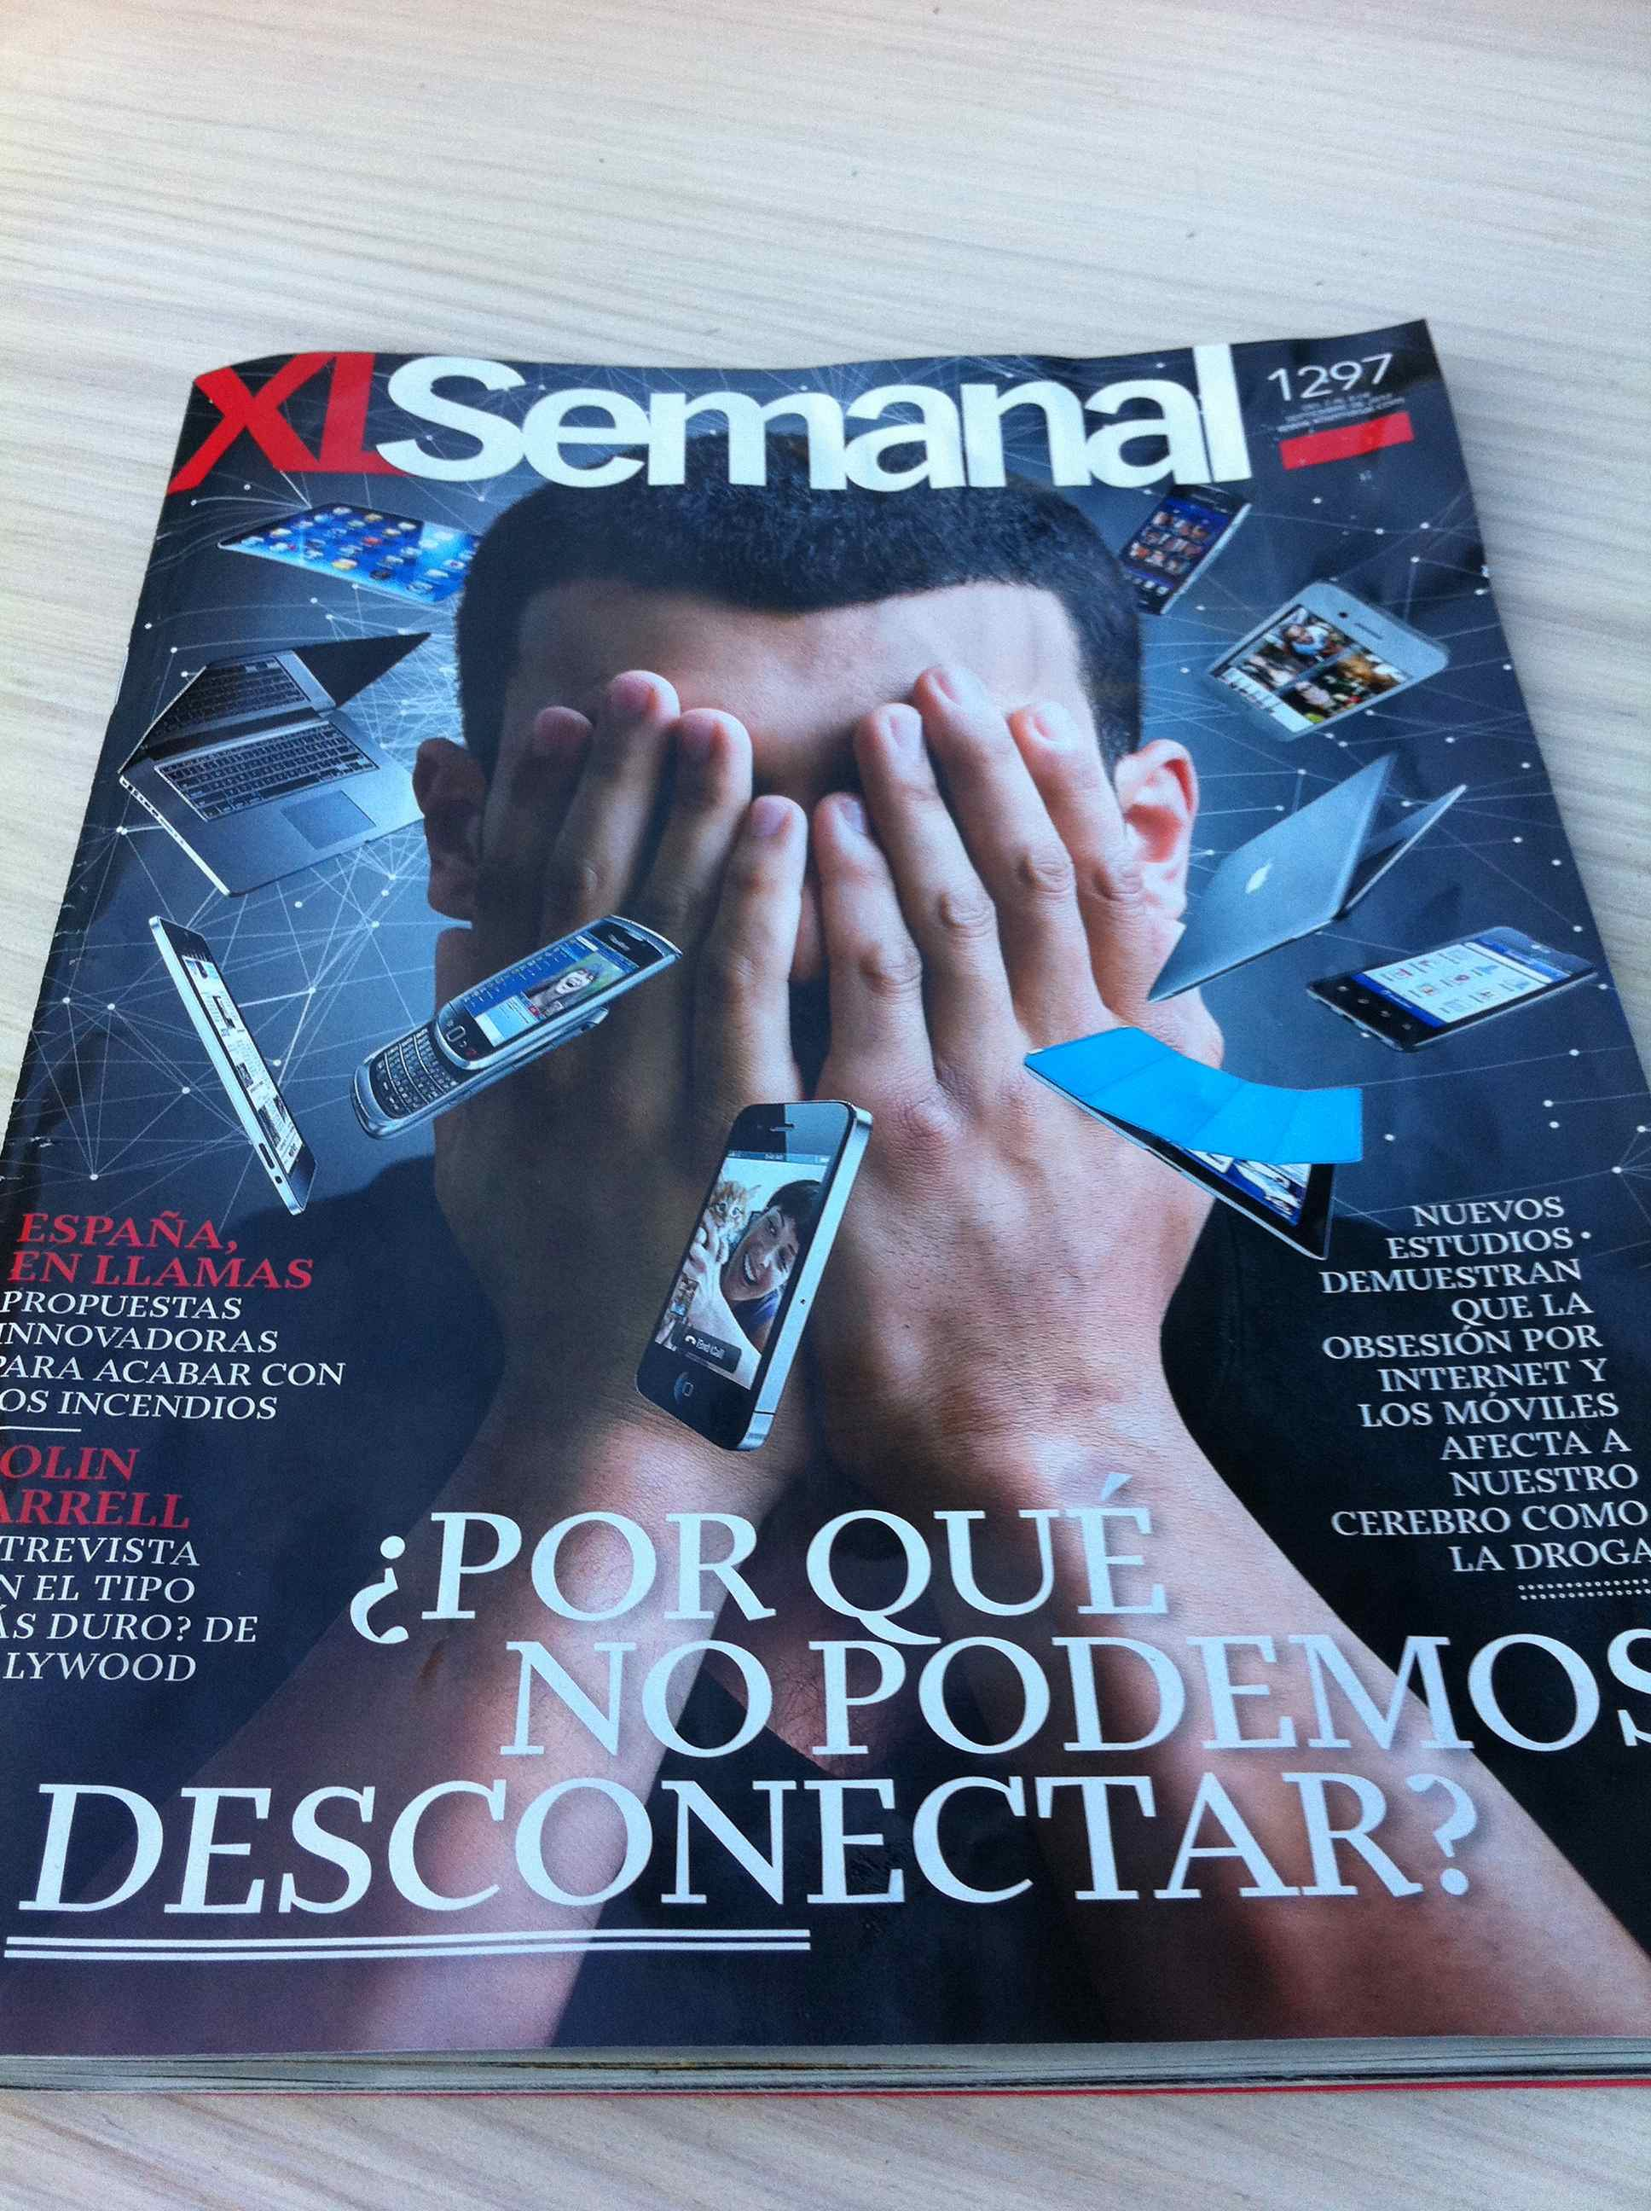
Technological trends
Mobiles and e-books
Games-based learning
Learning analytics
Gesture-based learning
The Internet of things
Personalised learning
Cloud computing
Ubiquitous learning
BYOD (Bring your own device)

Slide 6
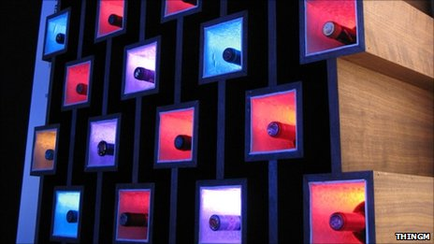
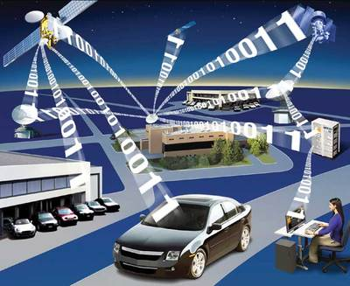
The Internet of things
People, resources, things
Semantic connectivity

Slide 7

Google glasses project
Can ‘see’ the Internet on glasses
Context sensitive information
Context lenses planned

Slide 8

Technologies for learning
Audio-graphics
Blogs
E-Books
E-Portfolios
Games
Instant Messaging
Mashups
Mobile learning
Photo sharing
Podcasts
RSS feeds
Second life
Social bookmarking
Twitter
Video Mesaging
Wikis
Video clips and YouTube
Video chat
Rennie and Morrison, 2012

Slide 9
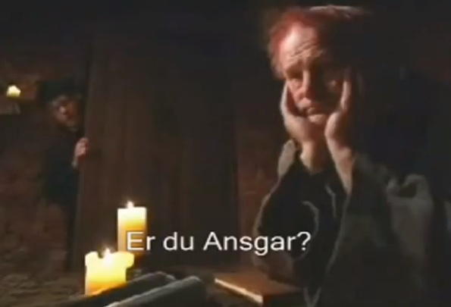

Slide 10

Teacher practices: paradoxes
Technologies not extensively used (Molenda)
Lack of uptake of OER (McAndrew et al.)
Little use beyond early adopters (Rogers)
Despite rhetoric and funding little evidence of transformation (Cuban, Ehlers)
Pandora’s box

Slide 11

Promise and reality
Social and participatory media offer new ways to communicate and collaborate
Not fully exploited
Wealth of free resources and tools
Replicating bad pedagogy
Lack of time and skills

Slide 12
Learning Design
Shift from belief-based, implicit approaches to design-based, explicit approaches
Learning Design
A design-based approach to creation and support of courses
Encourages reflective, scholarly practices
Promotes sharing and discussion

Slide 13
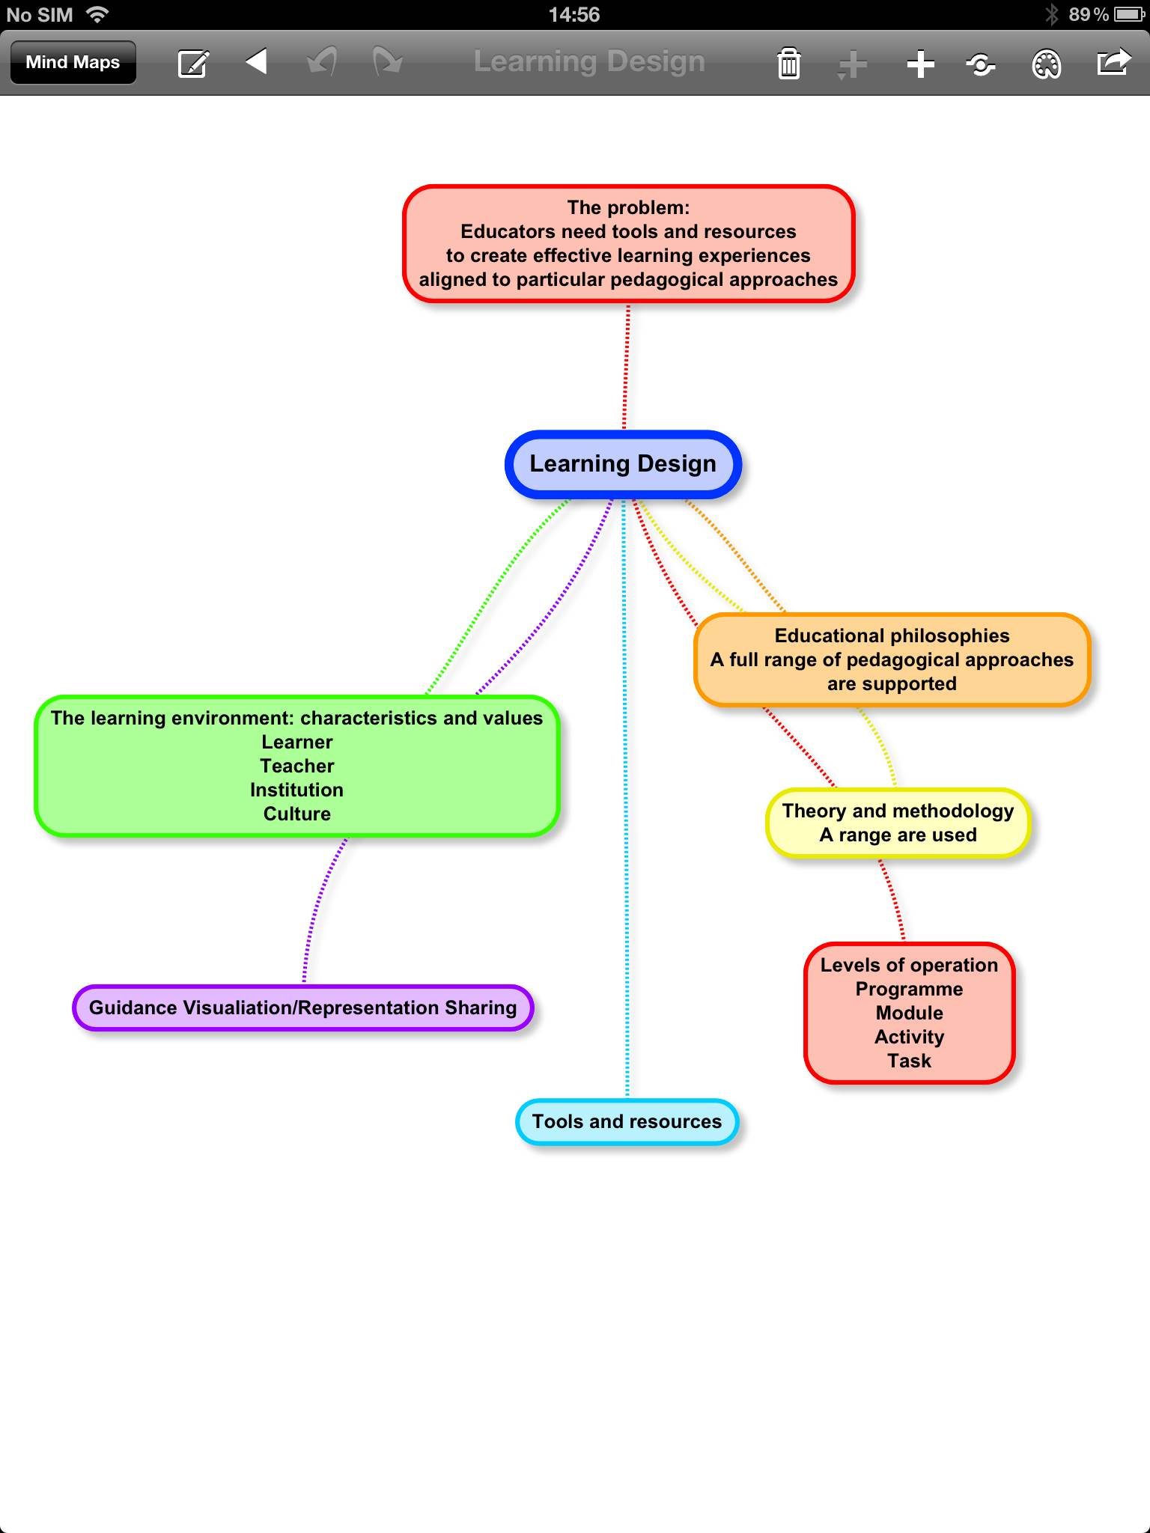

Slide 14
Socio-cultural perspectives
Design Mediating Artefacts
Concepts
Tools
Dialogues
Activities
Mediating
Artefacts (MA)
Creates
Learning activity
or Resource
Teacher
Has an
inherent
Design
Research focus
What Mediating Artefacts do teachers use?
What Mediating Artefacts can we create to guide the design process?
Other teachers and learners
can use or repurpose
Vygotsky, Activity Theory

Slide 15
Design-Based Research
A systematic, but flexible methodology aimed to improve educational practice through iterative analysis, design, development and implementation, based on collaboration between researchers and practitioners in real-world settings, and leading to contextually-sensitive design principles and theories.
Wang and Hannafin, 2005

Slide 16
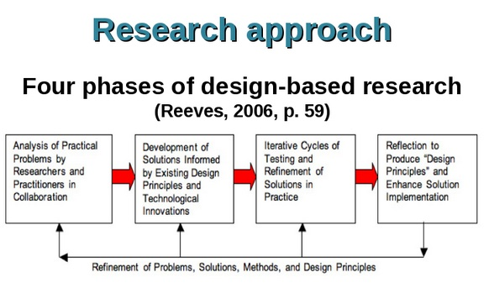
Means of dealing with real learning contexts
Iterative: design, implementation, evaluation, refine
Gives rich insights into complex dynamics

Slide 17

DBR and Learning Design
Builds on theory & prior research
Pragmatic
Collaborative
Contextual
Integrative
Iterative – problem, solution, evaluation
Adaptive and flexible
Generalisation
Builds on ID, OER, Ped Patterns research etc.
Practical tools & resources
Work with practitioners
Real, authentic contexts
Mixed-method approach
Problem, implementation, evaluation and refinement
Agile, based on practice
Coherent LD framework

Slide 18
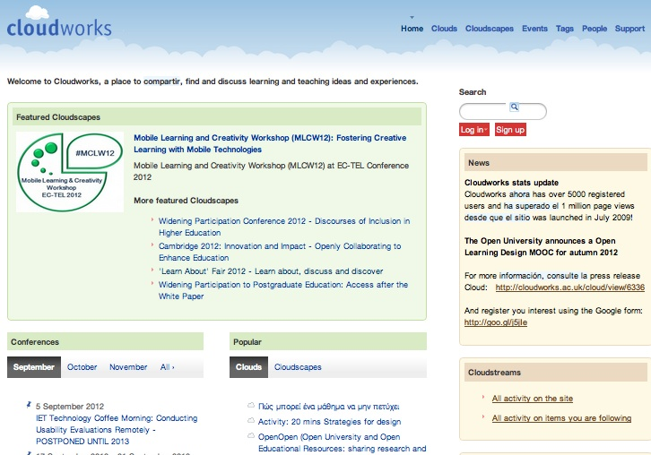
Problem and solution
Teachers want
Examples of good practice
Others to talk to
Solution
Social networking site
Best of web 2.0
Iterative design and evaluation
http://cloudworks.ac.uk

Slide 19
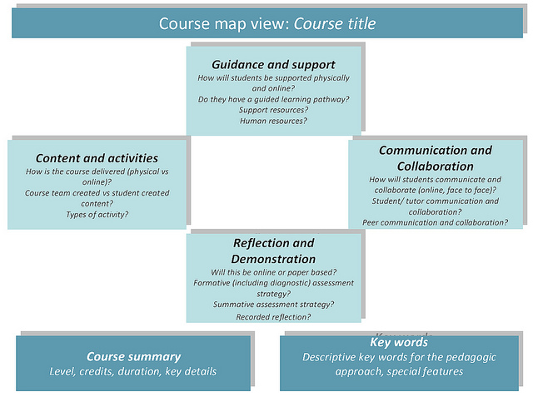
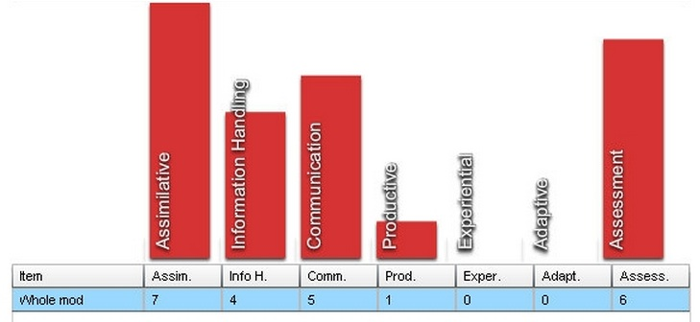
Problem and solution
Teachers want
Design guidance
Means to share and discuss designs
Solution
Design representations
Based on empirical evidence and theory

Slide 20
Conceptualise
What do we want to design, who for and why?
The 7Cs Framework
Consolidate
Evaluate and embed your design

Slide 21
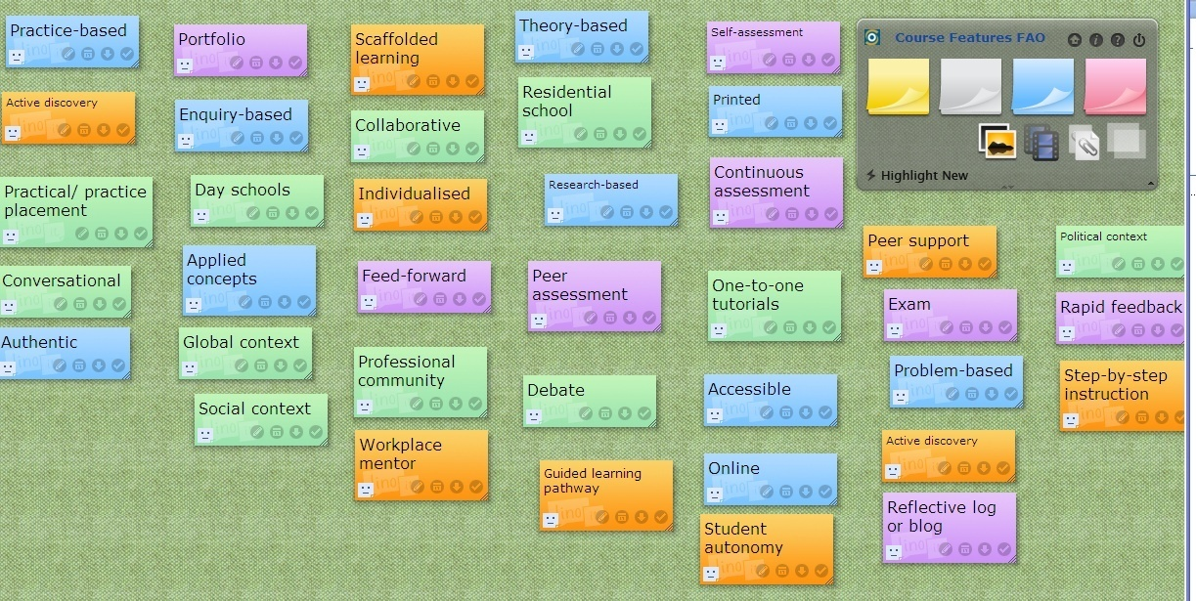
Course Features
http://linoit.com
Orange = Guidance and support
Blue = Content and activities
Purple = Reflection and demonstration
Green = Communication and collaboration

Slide 22
Course Map
Course/module summary:
Key words:
Guidance and support |  | Content and experience
Tools & resources | Responsibilities & relationships | Tools & resources | Responsibilities & relationships
1. 2. 3. 4. 5. 6. 7. |  | 1. 2. 3. 4. 5. 6. 7.
Reflection and demonstration |  | Communication and collaboration
Tools & resources | Responsibilities & relationships | Tools & resources | Responsibilities & relationships
1. 2. 3. 4. 5. 6. 7. |  | 1. 2. 3. 4. 5. 6. 7.

Slide 23
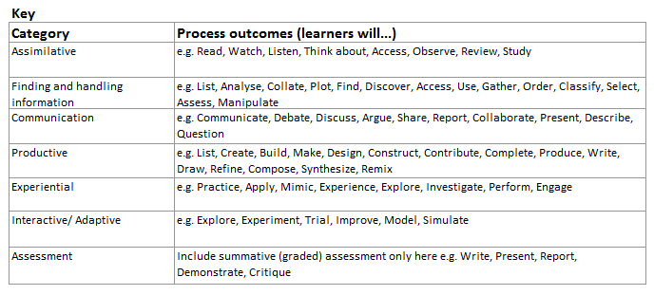
Activity Profile
http://tinyurl.com/ActivityProfileFlash
http://tinyurl.com/ActivityProfileExcel

Slide 24
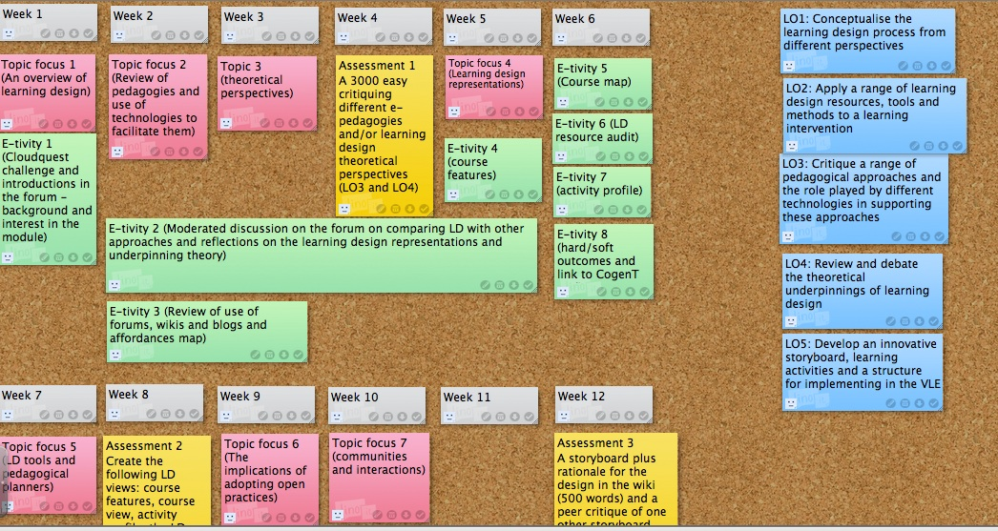
Storyboard
http://linoit.com

Slide 25
Evaluation of 7Cs
We made a big breakthrough. We have achieved the insight about the need to structure it as a course, an online course, and not just simply as a set of learning activities plus integrated resources.
The visual nature of the tools and the quick and easy way that one could use it without too much elaborative training. They help stimulate us to look at the course in a different way, in a natural and creative way even if we didn’t see all the little links right upfront.
It’s a way of freeing your mind and putting all the ideas of all the people in the course team down somewhere, not having to be so prescriptive. It was just a much freer and [more] creative experience than getting the learning outcomes and writing them as active verbs, and getting in at a granular level. It was quite sort of a liberating thing to just have everybody move components around and say, ‘Do you know I really like all these features. I’d like to do some problem-based learning. I’d like to do peer-review.’
I wanted to have my thinking challenged with regard to course design and development and I definitely left reflecting and questioning our unit's current approach and have some good tools and approaches to pilot with course design teams.
Ming Nie
www2.le.ac.uk/departments/beyond-distance-research-alliance/projects/speed

Slide 26
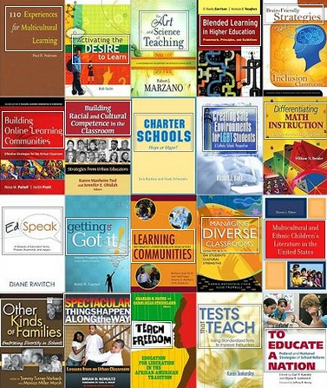
Facets of education
Resources
Learning
pathways
Support
Accreditation
http://www.flickr.com/photos/emclibrary/2459359483/

Slide 27

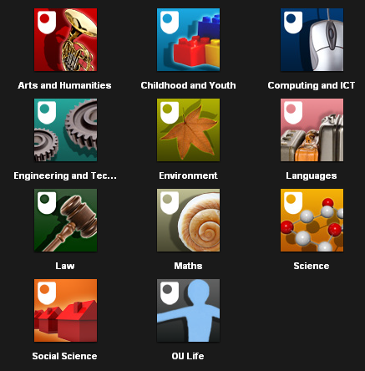

Resources
Over ten years of the OER movement
Hundreds of OER repositories worldwide
Evaluation shows lack of uptake by teachers and learners
Shift from development to community building and articulation of OER practice
Podcasts - iTunes U
Open Educational Resources

Slide 28
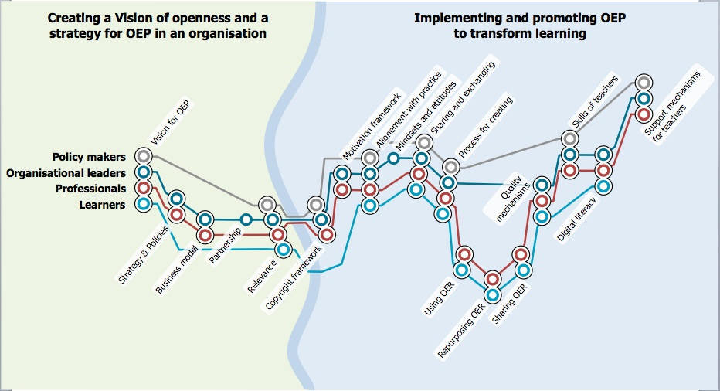
The OPAL metromap
http://www.oer-quality.org/

Slide 29

Outputs
Inventory of more than 100 OER initiatives
11 country reports and 13 mini-reports
7 in-depth case studies
3 EU-wide policy papers
7 options brief packs for EU nations/regions

Slide 30
Country reports: key themes
Diversity of educational contexts and maturity of internet provision and use of e-learning
Differences in policy support and funding for OER initiatives
Diversity from basic OER awareness to OER maturity and embedding
Few national OER initiatives

Slide 31
UK Country Report
Funding mainly from government – top-down
Funding mainly on production/producers, little on end-users or impact on learning
Mainly HE/FE, little school-based
Most institutions don’t have an OER strategy
Lots on cascading and transferring of experience
Most institutions have an OER repository
Related work: iTunesU and MOOCs
Ming Nie

Slide 32
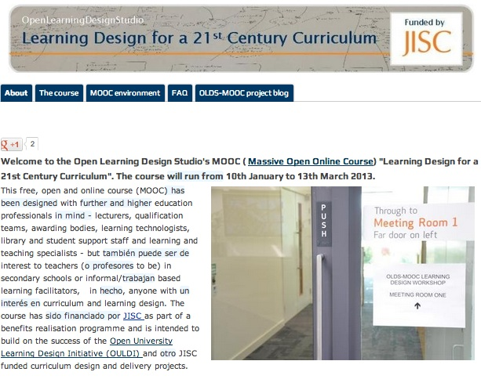
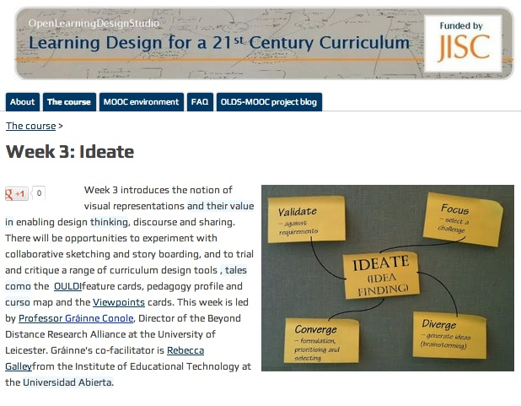
Massive
Open
Online
Course
http://www.olds.ac.uk/
http://www.youtube.com/watch?v=eW3gMGqcZQc

Slide 33
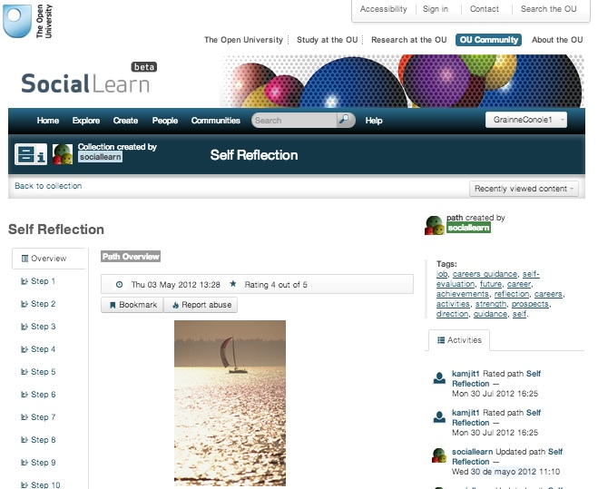
Learning pathways
http://sociallearn.open.ac.uk/

Slide 34

Support
Computer assisted
Peer support
Tutor support
Community support
Mentoring
http://www.flickr.com/photos/24289877@N02/5851058394/

Slide 35
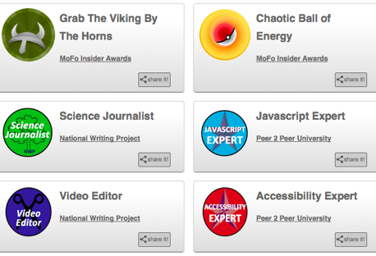

Accreditation
Peer to Peer University
OER University
www.p2pu.org/en/
wikieducator.org/OER_university/

Slide 36
Mapping e-Pedagogies to technologies
Pedagogies
Technologies
Problem-Based Learning (PBL)
Inquiry-Based Learning (IBL)
Didactic (Did)
Reflection (Ref)
Dialogic Learning (Dial)
Collaboration (Collab)
Assessment (Ass)
Communities of Practice (CoP)
IBL – social
User-Generated Content (UGC)
Virtual Worlds (VW)
Google
E-Books
Blogs, e-Portfolios
Discussion Forums (DF)
Wikis
MCQs
Google+
Twitter
Youtube

Slide 37
A pedagogy framework
Social
Information
Informal
Formal
Experience
Individual

Slide 38
IBL/Twitter
Social
PBL/VW
CoP/Google+
Dial/Skype
Dial/forum
Collab/Wiki
Informal
Formal
Ref/Blog
Ref/e-Portfolio
IBL/Google
UGC/YouTube
Did/e-Book
Individual
Ass/MCQs

Slide 39
Ref/Blog
Experience
PBL/VW
CoP/Google+
Dial/Skype
Ref/e-Portfolio
Dial/Forum
Informal
Formal
IBL/Twitter
Coll/Wiki
IBL/Google
UGC/YouTube
Did/e-Book
Information
Ass/MCQs

Slide 40
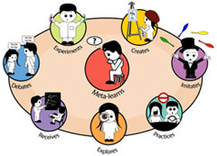
Pedagogies of e-learning
Mayes & De Freitas, 2004
Conole 2010
E-Assessment
Drill & practice
A
Inquiry learning
Collective intelligence
Resource-based
Associative
Focus on individual
Learning through association and reinforcement
Constructivist
Building on prior knowledge
Task-orientated
Situative
Learning through social interaction
Learning in context
Connectivist
Learning in a networked environment
Experiential, Problem-based Role play
Reflective & dialogic learning,
Personalised learning

Slide 41
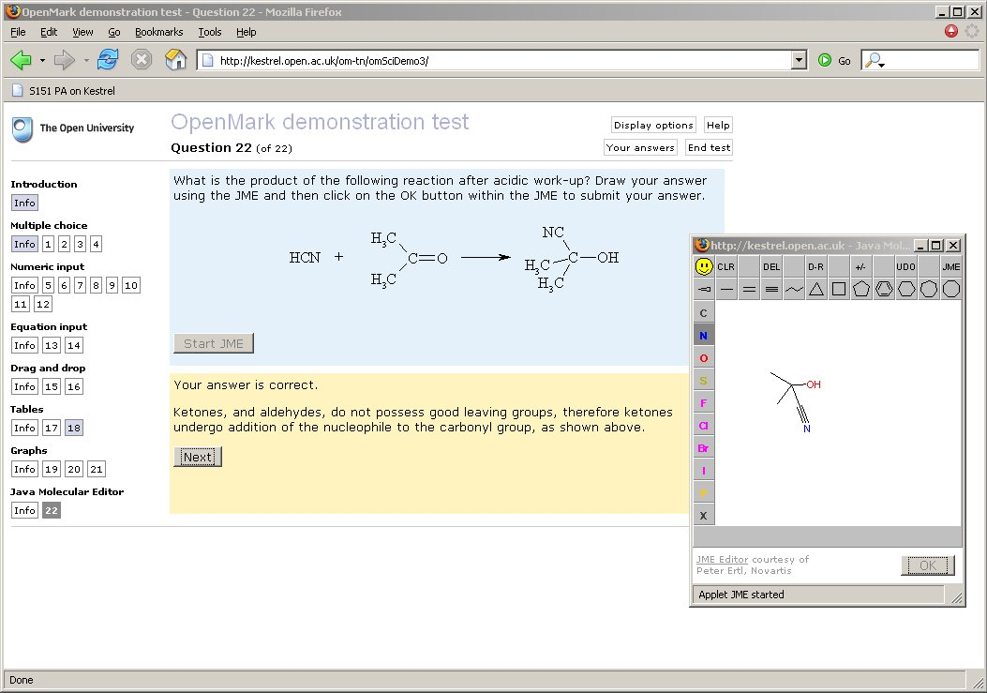
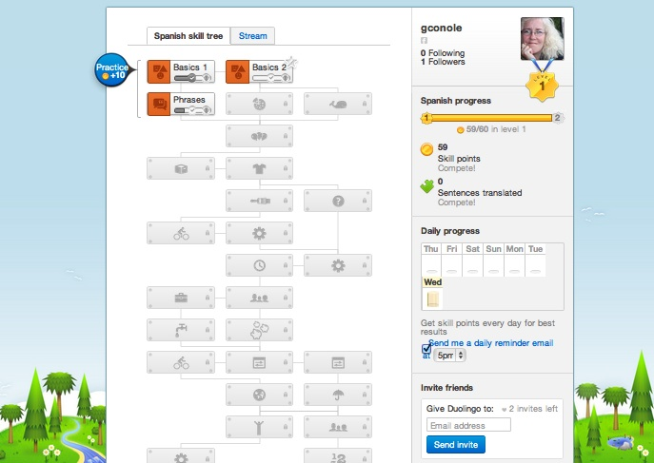
E-Assessment, drill and practice

Slide 42
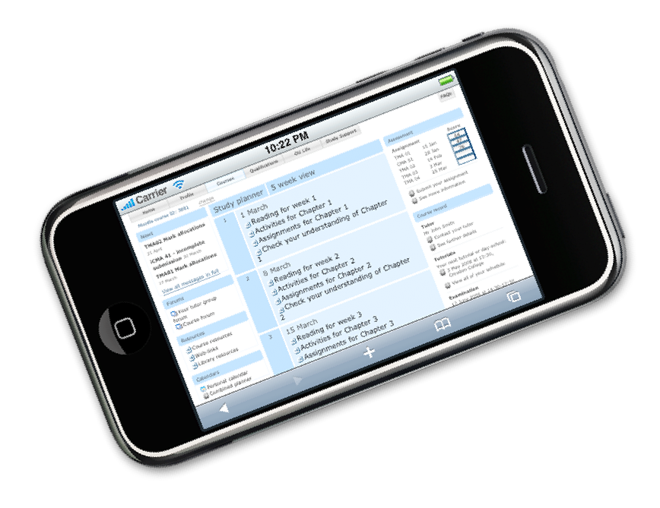
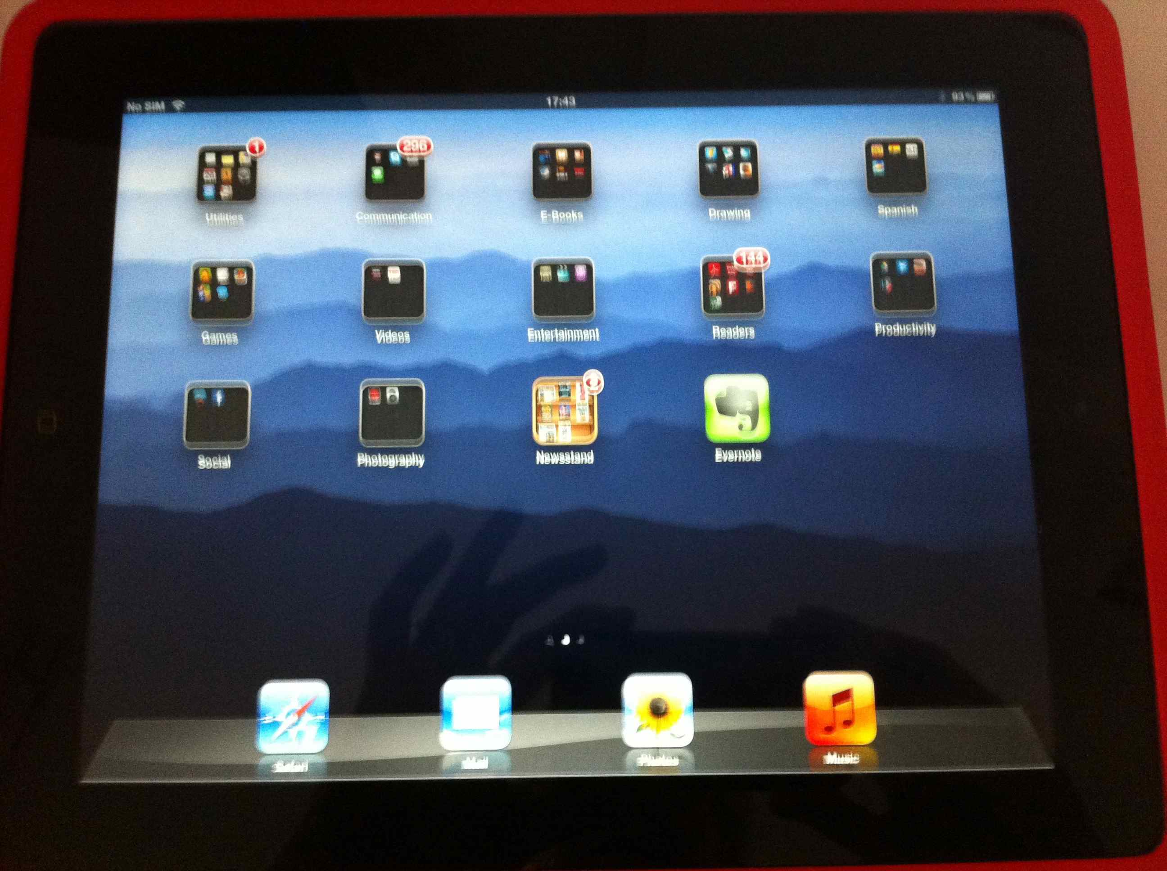
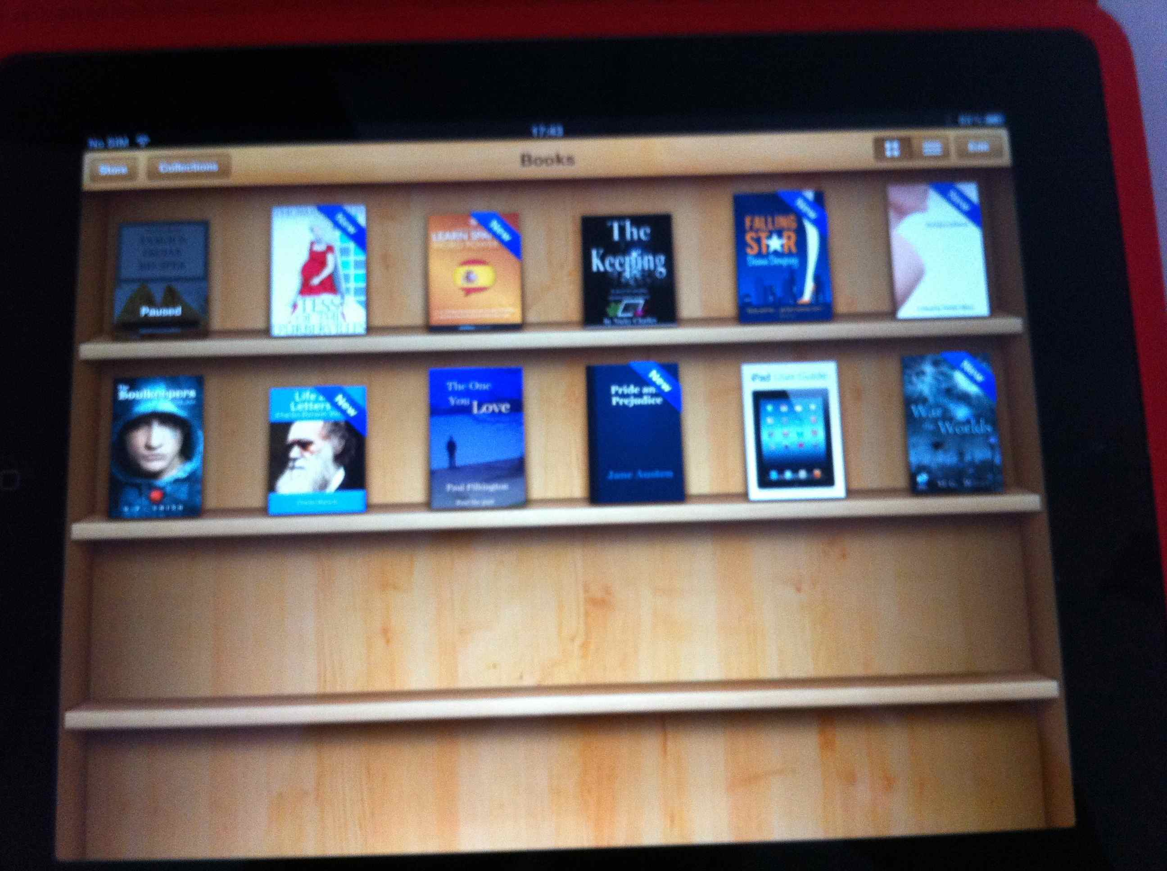
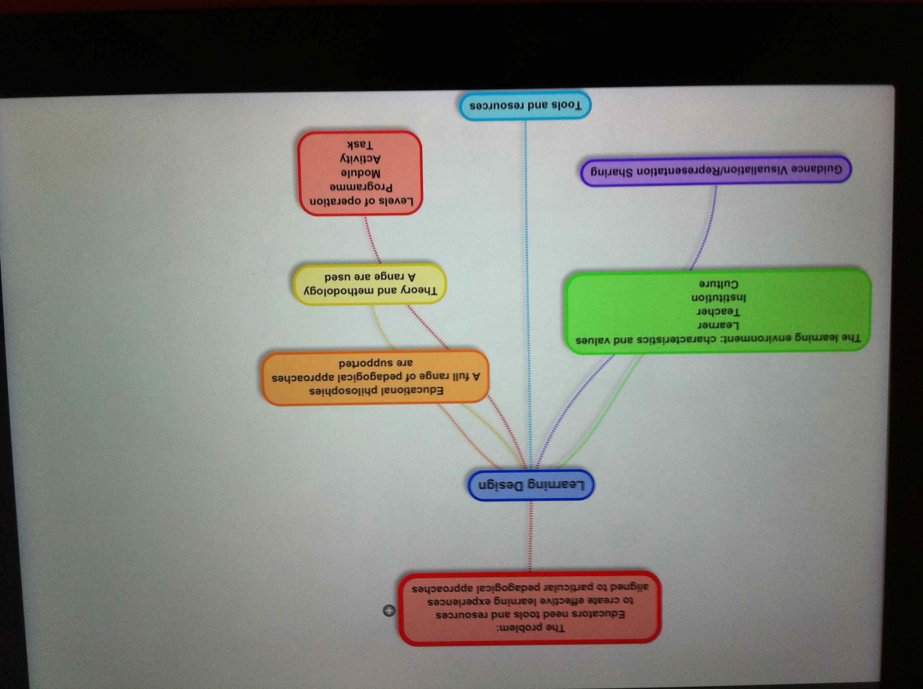
Mobile learning
Study calendars
E-books
Learning resources
Online modules
Annotation tools
Mind mapping tools
Communication mechanisms

Slide 43
Collective intelligence

Slide 44
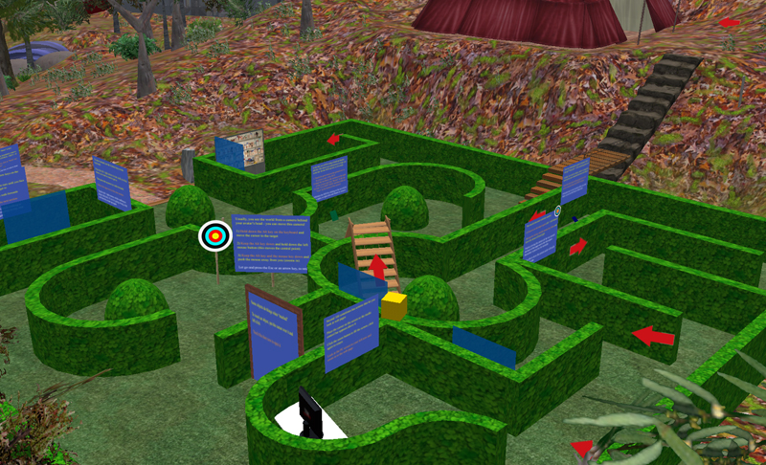

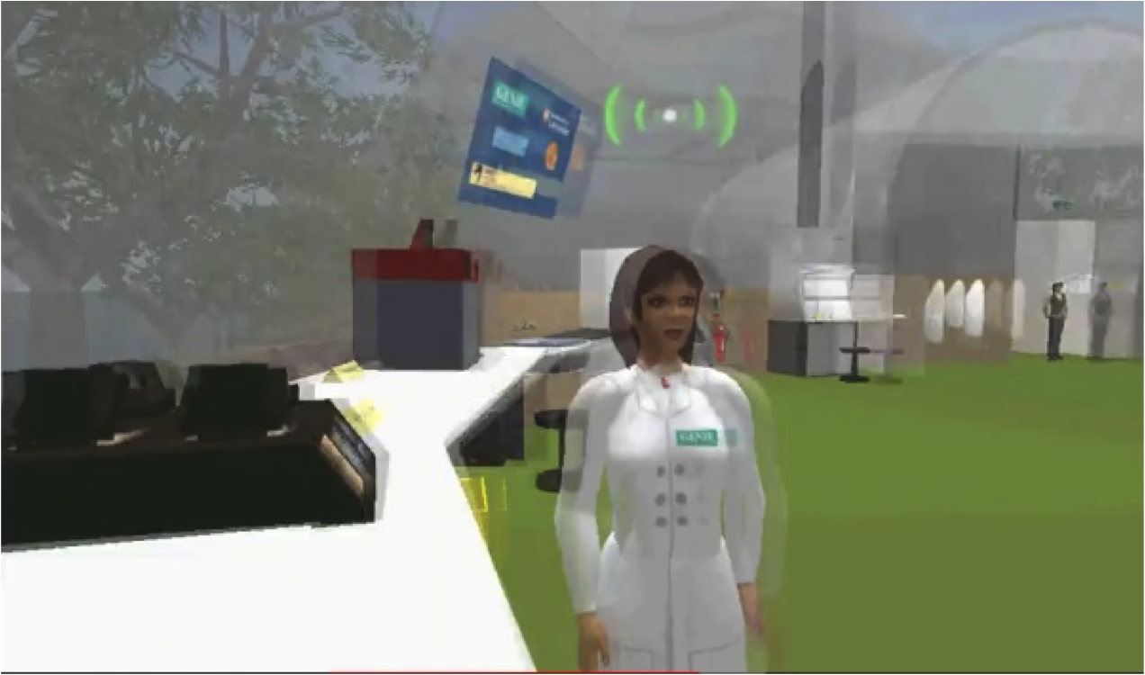
Situated learning and role play
Archeological digs
Medical wards
Art exhibitions
Cyber-law
Virtual language exchange
Beyond formal schooling

Slide 45
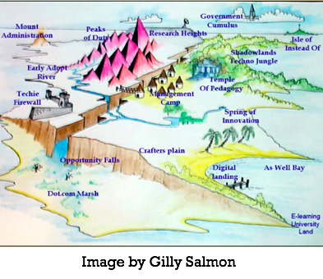
Ecologies of learning
Co-evolution of tools and users
Niches colonisation of new habitats
Survival of the fittest

Slide 46
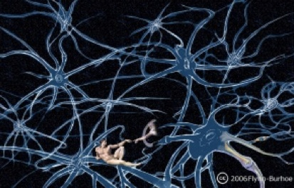
Rhizomatic learning
A rhizome is a stem of a plant that sends out roots as it spreads. Describes the way that ideas are multiple, interconnected and self-replicating. A rhizome has no beginning or end like a learning process
http://davecormier.com/edblog/2011/11/05/rhizomatic-learning-why-learn/

Slide 47

Conclusion
Disaggregation: resources, support, learning pathways and accreditation
What is the role of traditional institutions?
How can we harness the power of new media?
http://www.flickr.com/photos/ssoosay/6738302627/

Slide 48
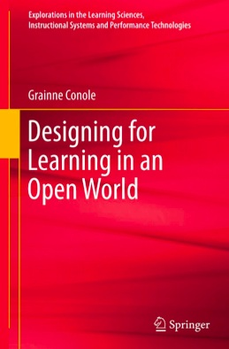

http://www.slideshare.net/GrainneConole
http://www2.le.ac.uk/departments/beyond-distance-research-alliance
grainne.conole@le.ac.uk
http://e4innovation.com

Slide 49
Useful sites and resources
OULDI website http://www.open.ac.uk/blogs/OULDI/
Carpe Diem website http://www.le.ac.uk/carpediem
7Cs OER page http://www2.le.ac.uk/projects/oer/oers/beyond-distance-research-alliance/7cs-workshop-resources
Cloudworks http://cloudworks.ac.uk/cloudscape/view/2406
Slideshare
http://tinyurl.com/7cs-bdra-11april

